Slide 1
IMPLEMENTATION OF SHORTER TERM REGIMEN FOR DRUG SENSITIVE TB IN CHILDREN:UPDATES
DR EVERLYNE AGISA KEGODE
CONSULTANT PAEDIATRICIAN AND PULMONOLOGIST
TB AND LUNG HEALTH SYMPOSIUNM
29TH SEP 2025

Slide 2
OVERVIEW
INTRODUCTION
EVIDENCE FOR SHORT TERM TB REGIMENS
SHORT TERM TB REGIMENS AVAILABLE FOR CHILDREN
MONITORING AND EVALUATION
SUMMARY

Slide 3


Burden of TB in children and adolescents in Kenya, 2018-2023
Kenya had an estimated 17,000- 24,000 children between 0-14 years with TB (WHO 2022)
In 2023, 12,884 were notified representing approx. 64% of the estimated cases
This was 13.3% of the total 97,126 notified TB cases
Notes:
DS and DR TB
36% missing cases

Slide 4
INTRODUCTION
Drug-susceptible tuberculosis (DS-TB) case
Patient with TB caused by a strain susceptible to first-line TB drugs. In practice, patients with a strain not resistant to rifampicin and isoniazid are recorded (and treated) as patients with DS-TB.
Drug-resistant tuberculosis (DR-TB) case
Patients with DR-TB should be classified into one of the following categories
Isoniazid-resistant TB (Hr-TB): susceptibility to rifampicin and resistance to isoniazid
Multidrug-resistant TB (MDR-TB) : resistance to at least rifampicin and isoniazid
Rifampicin-resistant TB (RR-TB) : resistance to rifampicin, with or without resistance to other TB drugs
Pre-extensively drug-resistant TB (pre-XDR-TB): MDR/RR-TB with additional resistance to any fluoroquinolone
Extensively drug-resistant TB (XDR-TB): MDR/RR-TB with additional resistance to any fluoroquinolone, and at least either bedaquiline or linezolid.

Slide 5
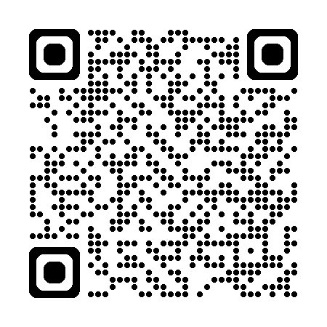
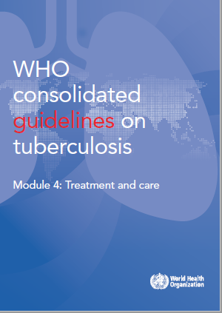
Overview of 2025 guidelines DS-TB chapter (2)
There are 11 DS-TB treatment recommendations
in the 2025 update:
The 4-month regimen for people aged 12 years or older with drug-susceptible pulmonary TB
The 4-month regimen for children and adolescents between 3 months and 16 years of age with non-severe TB
5 recommendations for treatment of drug-susceptible TB using 6-month regimen
2 recommendations for drug-susceptible TB treatment and antiretroviral therapy (ART) in people living with HIV
2 recommendations on the use of adjuvant steroids for the treatment of TB pericarditis and meningitis
2025
https://tbksp.who.int/en/node/2951

Slide 6
Background
New developments in 2022: Guidelines
4-month 2HPMZ/2HPM regimen
4-month 2HRZE/2HR regimen for children
Consolidating all recommendations on DS-TB (2021)
DS-TB guidelines 2021 (update)
DS-TB

Slide 7
Evidence: 4-month 2HPMZ/2 HPM: Data and studies considered
Study31/A5349 : A randomized, open-label, controlled phase 3 clinical trial
A recent phase III trial ‘’Study 31’’ (TBTC study 31/ACTG A5349, or S31/A5349) assessed the safety and efficacy of two 4-month regimens for the treatment of DS-TB.
A total of 2 516 patients from 13 countries (in Brazil, China, Haiti, India, Kenya, Malawi, Peru, South Africa, Thailand, Uganda, USA, Viet Nam and Zimbabwe) were randomly assigned to the treatment regimen.
Study 31 is the first and only phase III trial demonstrated the noninferiority of the 4-month regimen for treatment of DS-TB when compared to the standard of care
There was little or no difference in all-cause mortality and adverse events during treatment – a slight increase in retention on treatment was noted in the rifapentine-moxifloxacin arm.

Slide 8
Evidence: 4-month 2HRZ(E)/2 HR: Data and studies considered
2. SHINE trial : Shorter treatment for non-severe tuberculosis
Shorter treatment for non-severe tuberculosis in African and Indian children (SHINE), phase 3 randomized trial evaluated duration of TB treatment in children with non-severe DS-TB.
The trial showed that a 4-month treatment regimen, 2HRZ(E)/2HR, was non-inferior to the standard 6-month regimen (2HRZ(E)/4HR).
Experimental regimen: 4-months (16 weeks) of TB treatment using WHO-recommended pediatric doses.
Comparator: 6 months (24 weeks) of treatment using WHO-recommended pediatric doses

Slide 9
Recommendations
Treatment of DS-TB using 6-month regimen
Recommendation 1: New patients with pulmonary TB should receive a regimen containing 6 months of rifampicin: 2HRZE/4HR
(strong recommendation, high certainty of evidence)
Remarks
A: The recommendation also applies to extrapulmonary TB – except TB of the central nervous system, bone or joint for which some expert groups suggest longer therapy.
B: WHO recommends that national TB control programmes provide supervision and support for all TB patients in order to ensure completion of the full course of therapy.
C: WHO recommends drug resistance surveys (or surveillance) for monitoring the impact of the treatment programme, as well as for designing standard regimens.

Slide 10
Recommendations
Treatment of DS-TB using 6-month regimen
Recommendation 2:
Wherever feasible, the optimal dosing frequency for new patients with pulmonary TB is daily throughout the course of therapy.
(strong recommendation, high certainty of evidence)
Recommendation 3:
In all patients with DS PTB, the use of 3x dosing is not recommended in both the intensive and continuation phases of therapy, and daily dosing remains the recommended dosing frequency
(conditional recommendation, very low certainty of evidence).
Recommendation 4:
The use of fix-dose combination (FDC) is recommended over separate drug formulations in treatment of patients with DS-TB.
(conditional recommendation, low certainty of evidence)
Recommendation 5:
In new PTB patients treated with the regimen containing rifampicin throughout treatment, if a positive sputum smear is found at completion of the intensive phase, the extension of the intensive phase is not recommended .
(strong recommendation, high certainty of evidence)

Slide 11
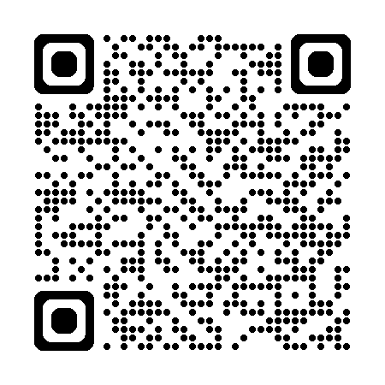
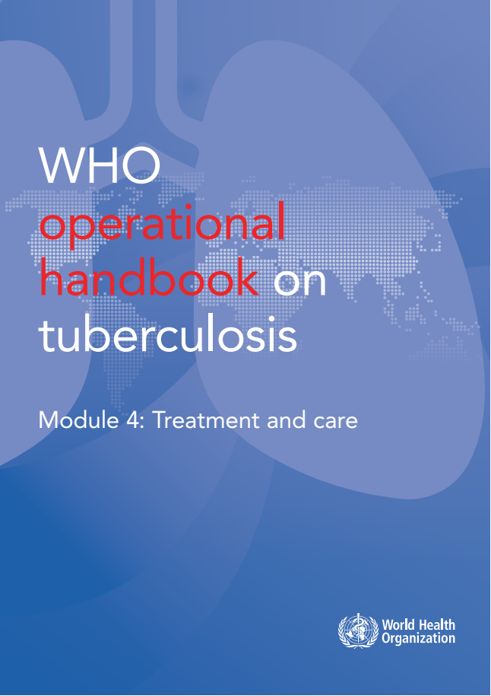
Operational Handbook
https://tbksp.who.int/en/node/3011
What are the treatment options for DS-TB patients?
2025
2HRZE/4HR
Applicable for ages 12 years old and above
2HRZ(E)/2HR
For children and adolescents between 3 months and 16 years of age
2HPMZ/2HPM
Can be used with PLHIV with a CD4 count > 100 cells/mm3;
Can be used regardless of HIV status or disease severity.
Considered safe for pregnant woman;
Can be used in all age groups;
Without severe extrapulmonary TB
pregnant, breastfeeding and postpartum women cannot benefit from this regimen
with non-severe TB
without suspicion or evidence of MDR/RR-TB

Slide 12
Recommendations
Treatment of DS-TB using 4-month regimens
Recommendation 6: People aged 12 years or older with drug-susceptible pulmonary TB, may receive a 4-month regimen of isoniazid, rifapentine, moxifloxacin and pyrazinamide.
(conditional recommendation, moderate certainty of evidence)
Recommendation 7: In children and adolescents between 3 months and 16 years of age with non-severe TB (without suspicion or evidence of MDR/RR-TB), a 4-month treatment regimen (2HRZ(E)/2HR) should be used.
(strong recommendation, moderate certainty of evidence)
Remarks
Non-severe TB is defined as: Peripheral lymph node TB; intrathoracic lymph node TB without airway obstruction; uncomplicated TB pleural effusion or paucibacillary, non-cavitary disease, confined to one lobe of the lungs, and without a miliary pattern;
Children and adolescents who do not meet the criteria for non-severe TB should receive the standard six-month regimen (2HRZE/4HR), or recommended treatment regimens for severe forms of extrapulmonary TB.
The use of ethambutol in the first two months is recommended in settings with a high prevalence of HIV, or of INH resistance

Slide 13
Operational Handbook
The composition and duration of 4-month (2HPMZ/2HPM) regimen
4-month regimen: 2 H-P-M-Z / 2 H-P-M
Initial phase: 2 H-P-M-Z
Continuation phase: 2 H-P-M
Continuation phase involves 2 months of daily isoniazid, rifapentine and moxifloxacin.
Initial phase comprises of 2 months of daily isoniazid, rifapentine, moxifloxacin & pyrazinamide.
Daily dosing (7 days per week) is suggested; treatment supporters and video-supported treatment (VST) are means to enhance medication adherence and administration.
Duration is fixed at 4 month; prolonging beyond 4 months is not recommended

Slide 14
Operational Handbook
Who is eligible for a 4-month (2HPMZ/2HPM) regimen?
Adults and children aged 12 years or older with a body weight of more than 40 kg with pulmonary DS-TB are eligible for this regimen.
Except the following:
patients weighing less than 40 kg;
people with HIV with a CD4 count of less than 100 cells/mm3;
pregnant, breastfeeding and postpartum women
children and adolescents aged under 12 years;
patients with severe extrapulmonary TB (e.g. tuberculous meningitis, disseminated TB, osteoarticular TB or abdominal TB);

Slide 15
Operational Handbook
What criteria guide treatment choice in adolescents and adults?
Factors/conditions | 2 HRZE/4HR | 2HPMZ/2HPM
Age | No age restriction | Yes (12 years and above)
Weight | Any | > 40kg
Severe EPTB (meningitis, disseminated TB, osteoarticular TB or abdominal TB) | Yes | No
HIV infection | Regardless of CD4 count | CD4 count >100 cells/mm3
Pill burden | Fixed dose combination | Loose formulation
Duration of treatment | 6 months | 4 months
Pregnancy and breastfeeding | Yes | No
Other factors to be considered:
preferences of patients and clinicians feasibility of monitoring for drug adverse effects availability and cost of medicines

Slide 16
Operational Handbook
The composition and duration of 4-month (2HRZ(E)/2HR) regimen in children and adolescents
4-month regimen: 2 H-R-Z- (E) / 2 H-R
Initial phase: 2 H-R-Z- (E)
Continuation phase includes 2 months of daily isoniazid and rifampicin.
Initial phase comprises of 2 months of daily isoniazid, rifampicin and pyrazinamide, with or without ethambutol.
Daily dosing (7 days per week) is suggested; treatment supporters or VST can improve adherence.
Treatment should be continued for 6 months amongst those who have not responded clinically (i.e. haven’t demonstrated weight gain or resolution of TB symptoms).
Continuation phase: 2 H-R

Slide 17
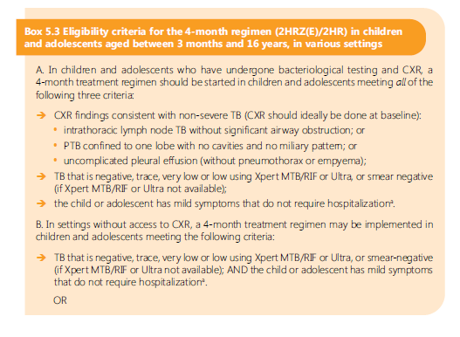
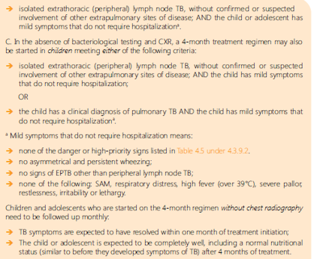
Operational Handbook
Who is eligible for a 4-month (2HRZ (E)/2 HR) regimen?
https://tbksp.who.int/en/node/2127

Slide 18
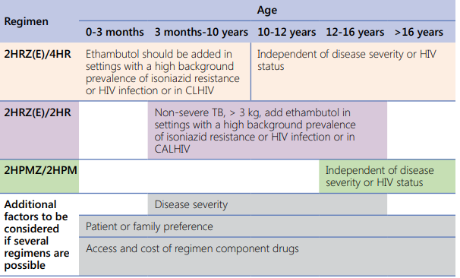
Operational Handbook
What key factors should be taken into consideration when making decisions about selecting the available treatment regimens?

Slide 19
Operational Handbook
What is the recommended dosing frequency for DS-TB in all patients?
The optimal dosing frequency for DS TB patients is daily throughout the course of therapy
Daily dosing remains the recommended dosing frequency for both HIV-negative people and people living with HIV
The term ‘daily’ indicates an intake of TB drugs for 7 days per week
Daily administration reduces the rate of acquired drug-resistance by up to 3 times when compared with intermittent dosage

Slide 20
Main messages
The 6-month regimen is applicable for all DS-TB patients regardless of age, including children, adolescents and adults.
While 4-month regimens represent a significant advancement in DS-TB treatment, they have certain limitations
For patients aged between 12 and 16 years, it is essential to follow specific criteria when selecting the appropriate treatment regimen.
Age, weight, duration, pill burden, severity of EPTB and other considerations should guide the decision when opting for 4-months regimens.

Slide 21
Tuberculosis treatment regimens for Kenya for children 1-10 years
 | Eligibility for 4 month regimen (Non-severe TB) (2RHZ(E)/2RH) | Eligibility for 6 month regimen (Severe TB) (2RHZ(E)/4RH) | Eligibility for 12 months
Age | ≥1 year to 10 years (Non-severe TB) | <1yr or 11 - 15 yrs 1yr to 10 yrs (severe TB) | All ages
Type of TB | Pulmonary TB Uncomplicated TB cervical lymphadenitis Stable enough to be managed as an outpatient at the point of diagnosis No danger signs | Severe Pulmonary TB Extra Pulmonary TB All hospitalized patients at the point of diagnosis Severely ill at diagnosis with any danger signs such as; Difficulty in breathing with associated central cyanosis, Grunting, Oxygen saturation <90%, Increased respiratory rate (age 0-2 months >60/min; 2-12 months >50/min; 1-5yr >40/min; 6-10yr >30/min); unable to drink/breastfeed; Weak or absent pulse; Coma/convulsing/confusion; Not responding to pain or unresponsive | TB Meningitis & Osteoarticular TB
Nutritional status | Normal/MAM/Overweight/Obese | Severe acute malnutrition (SAM)
Immune status | HIV negative No other immunosuppressive condition | HIV positive Any immunosuppressive condition (cancer, Diabetes, etc)
Bacteriologic status | Bacteriologically negative Clinically diagnosed | Bacteriologically confirmed
Treatment regimen | 4 months - 2RHZE / 2RH | 6 months - 2RHZE / 4RH | 12 months- 2RHZE / 10RH
*If the child has known contact with a person with DRTB, this table does not apply, start the child on treatment as per the DRTB guidelines

Slide 22
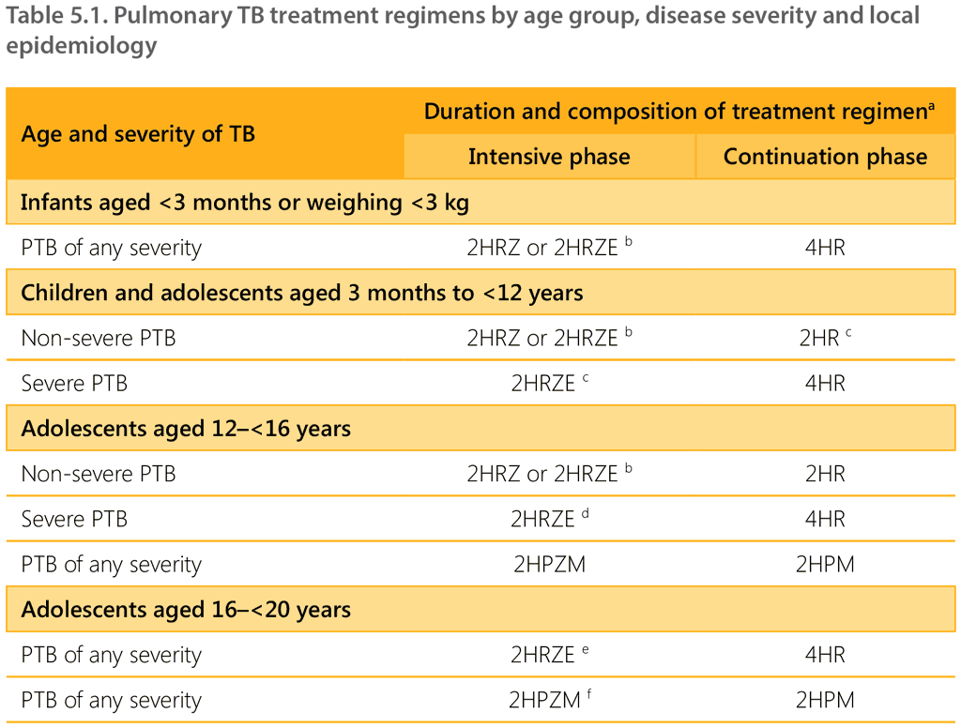
SUMMARY OF TB TREATMENT

Slide 23
Standard Practice:
Kenya has adopted this shorter 4-month regimen as the new standard for treating non-severe TB in children, replacing the 6-month regimen

Slide 24
Why the Change Matters:
Improved Treatment:
A shorter regimen means improved adherence and less toxicity for children, making treatment more feasible and effective.
Child-Friendly Formulations:
The use of child-friendly, fixed-dose combination (FDC) medicines makes it easier to administer the drugs correctly

Slide 25



Monitoring and Evaluation

Slide 26
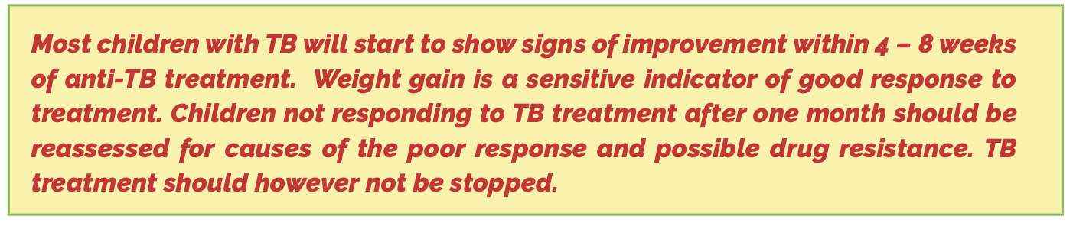
Monitoring of treatment
All children on treatment for Drug sensitive TB should be reviewed weekly during the intensive phase and two weekly during the continuation phase as per the guidelines
If during the course of treatment the child has any of the severe classification features, treatment should be converted to 6 months or 12 months if meningitis or osteoarticular and investigations for possible DR TB commenced as per the guidelines
Children with non severe TB on the four-month regimen (2RHZE/2RH)
All patients should be regularly monitored to assess their response to therapy. For those with bacteriological positive results at start of treatment, smear microscopy should be done at 2,5,and 6 months of treatment. Investigate for DR TB for those with treatment failure or poor response to treatment as per the guidelines
Children with severe TB on the six-month regimen (2RHZE/4RH)
Notes:
Guidelines: reviewed weekly during the intensive phase and two weekly during the continuation

Slide 27
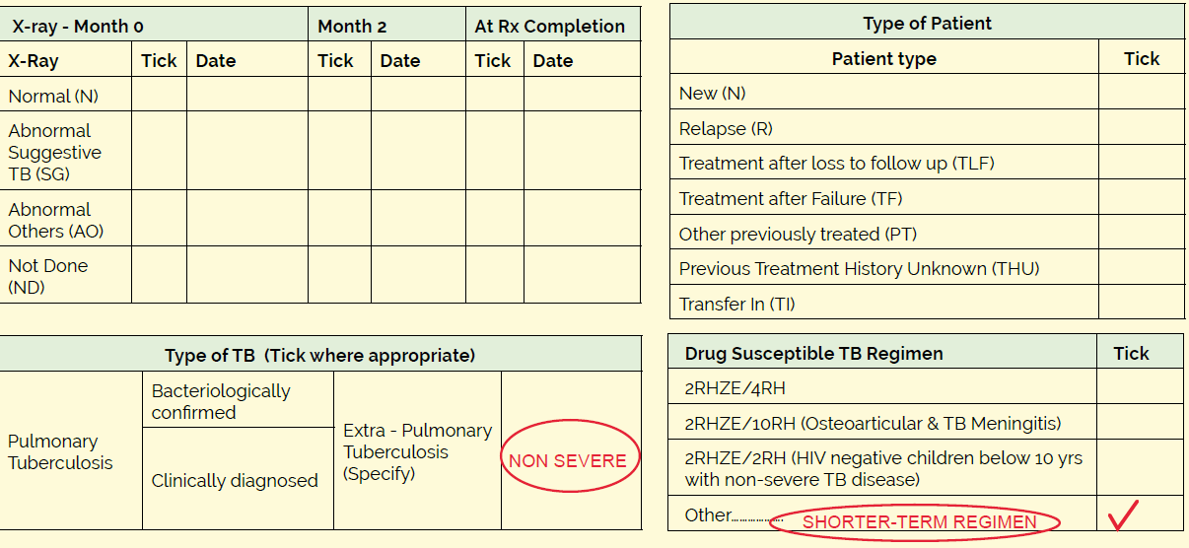

Document severity and regimen on TB5 as shown
Notes:
TB 5- patient record card

Slide 28
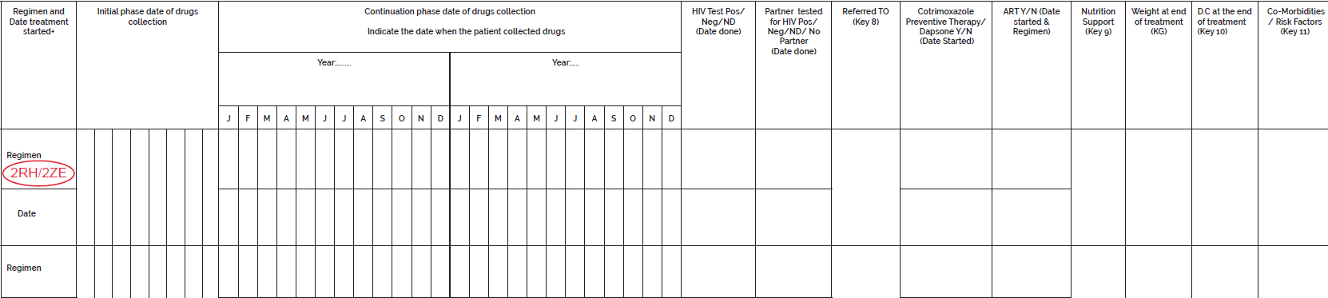
Document regimen onTB4 as shown
2RHZE/2RH
Notes:
TB4 register

Slide 29
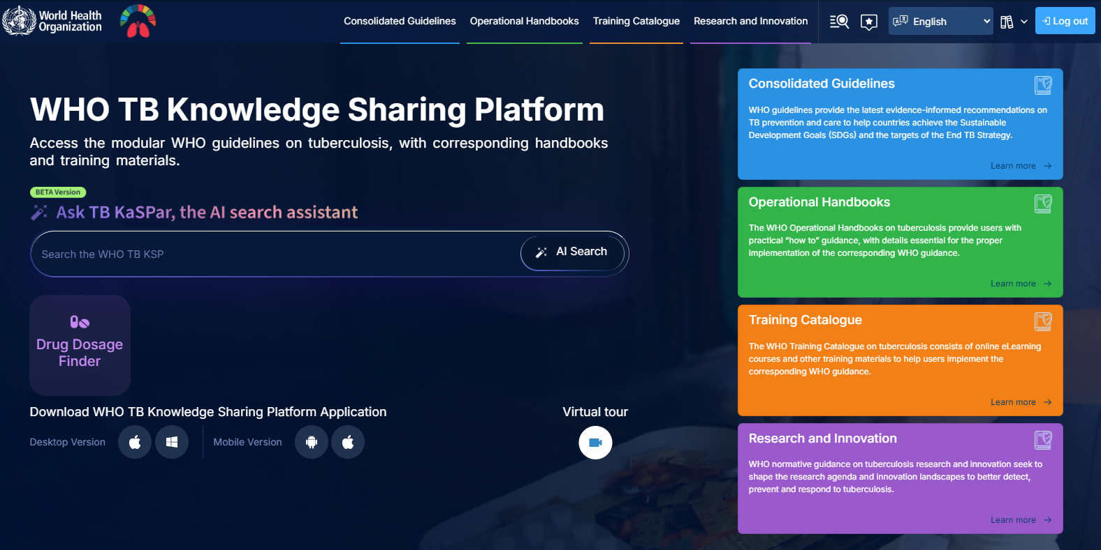
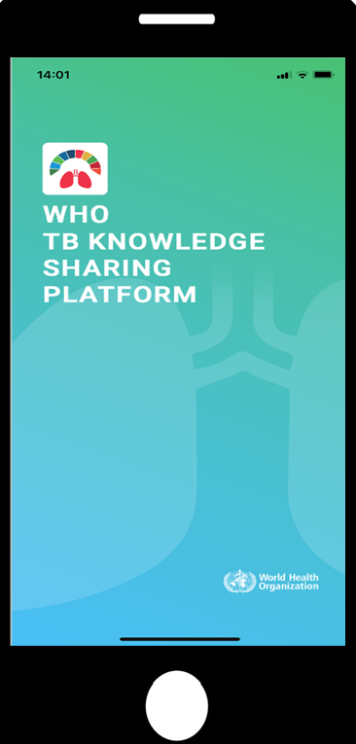
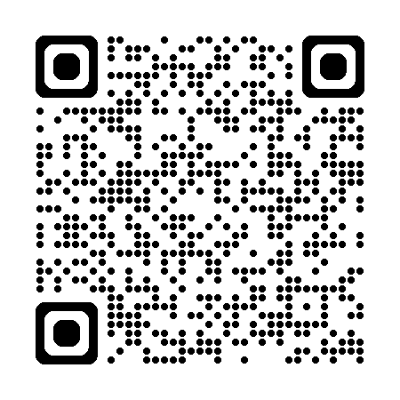
https://tbksp.who.int

Slide 30
THANK YOU!

